Slide 1
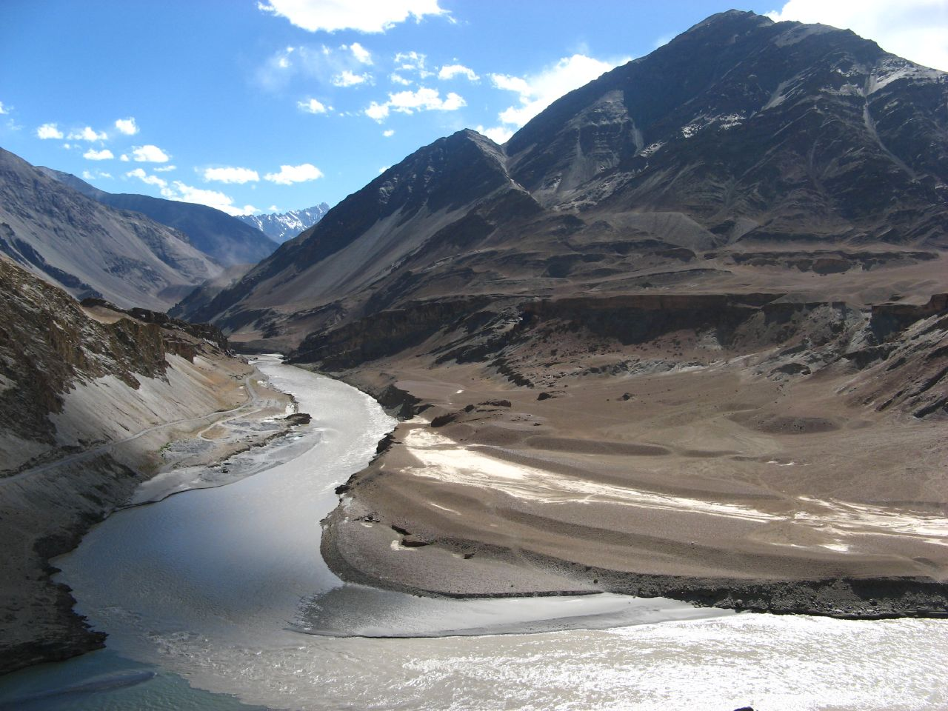
Museum of
Ancient
River
Civilizations
Notes:
Social Studies Grade 6

Slide 2
Driving Question
What information should we include in exhibits about Mesopotamia, Egypt, China, and Indus Valley for an ancient river civilizations museum gallery?

Slide 3
Scenario
Your class has been recruited to curate a museum about the ancient river civilizations. Each group will create an online presentation using Prezi to design the floor plan, including all exhibits and corresponding signage for each civilization.

Slide 4
Information
Each group must create 3 exhibits: Mesopotamia, Indus Valley, and China. Each exhibit must contain information regarding:
Communication
Religion
Culture
Government
Technology
Physical Geography
Timeline

Slide 5
Step 1
First, we must find out what a typical museum exhibit regarding ancient civilizations looks like. We will visit the LASM and view the Ancient Egypt exhibit. While viewing the museum exhibit, you must take notes about the communication, religion, culture, government, and technology of Ancient Egypt. Be sure to ask questions to the tour guide to get a better understanding of the civilization. You will also need to draw the floor plan of the gallery to understand the arrangement of exhibits.

Slide 6
Step 2
After our trip to LASM, we will work together as a class to recreate the floor plan of the gallery containing all of the information that we gather on our tour using the online presentation tool, Prezi.

Slide 7
Step 3
Next, you and your group will generate a list of questions for research about the timeline, communication, religion, culture, government, and technology of the following ancient river civilizations: Mesopotamia, Indus Valley, and China
What kinds of questions will you need to ask?

Slide 8
Step 4
Use the “Jog the Web” list of sites below to find answers to your questions and enter them on your note-taking guide.
Also, be sure to save any images and videos that might enrich your exhibits.

Slide 9
Step 5
Once you have all of your information, you will then be ready to curate the exhibits for the museum gallery. Use what you learned from the Ancient Egypt gallery at LASM and what you learned about each civilization to design a floor plan including all exhibits and corresponding signage for each civilization. Your exhibits can include images, videos, text, and podcasts.

Slide 10
Step 6
It is time to present your floor plans to our class!
Our class will vote and come to a consensus about a final proposal to submit to the museum director for consideration about a new museum gallery of ancient river civilizations.
Great work museum curators!

Slide 11
Lesson Created by
WBR Technology Department

